Slide 1
JS Design Pattern Day3
Presented By :Asmaa Ahmed

Slide 2
Facade Pattern
1
Facade is a structural design pattern that provides a simplified interface to a library, a framework, or any other complex set of classes.
this pattern adds an interface to existing system to hide its complexities.
This pattern involves a single class which provides simplified methods required by client and delegates calls to methods of existing system classes.

Slide 3
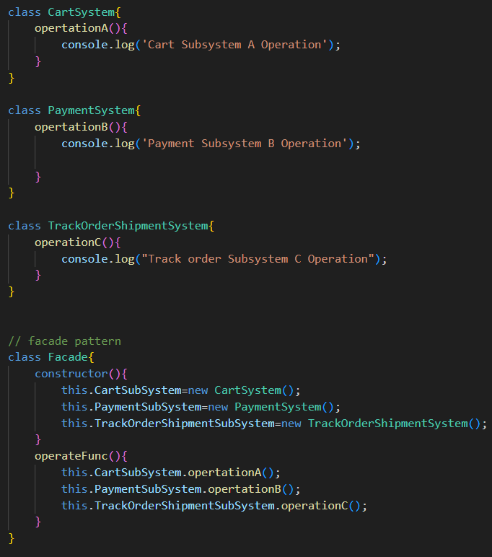
Facade Pattern
1

Slide 4
Decorator Pattern
2
Decorator is a structural design pattern that lets you attach new behaviors to objects by placing these objects inside special wrapper objects that contain the behaviors.

Slide 5
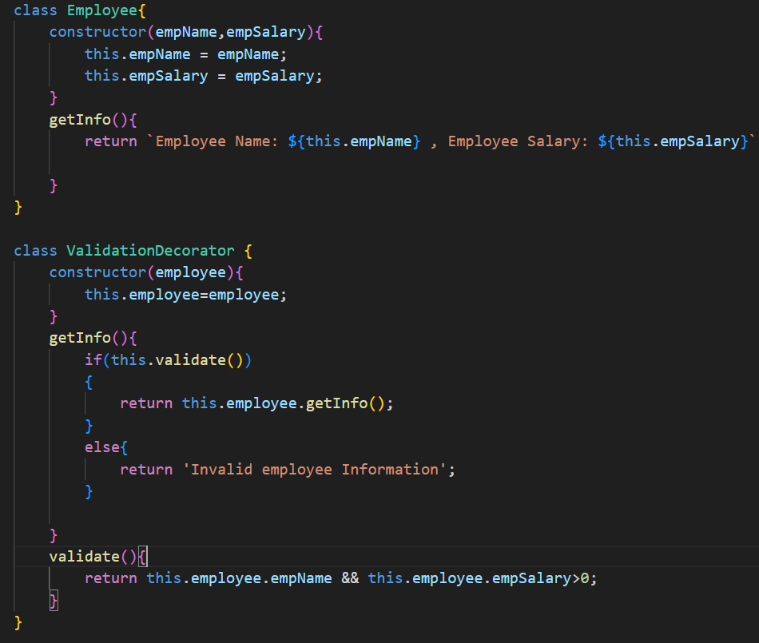
Decorator Pattern
2

Slide 6
Adapter Pattern
3
An Adapter Pattern says that just "converts the interface of a class into another interface that a client wants". In other words, to provide the interface according to client requirement while using the services of a class with a different interface.

Slide 7
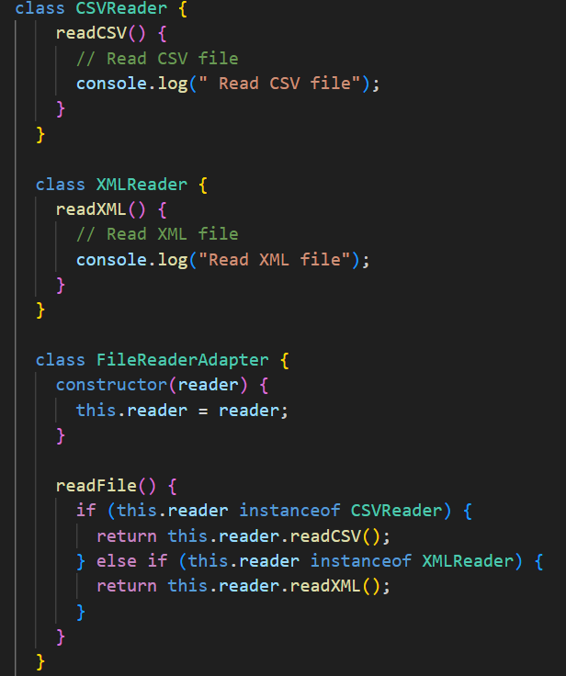
Adapter Pattern
3

Slide 8
Solid Principles
SOLID is an acronym for the first five object-oriented design (OOD)
principles by Robert C. Martin (also known as Uncle Bob).
SOLID is an acronym that stands for five key design principles:
● single responsibility principle.
● open-closed principle.
● Liskov substitution principle.
● interface segregation principle.
● dependency inversion principle.
All five are commonly used by software engineers and provide some important
benefits for developers.

Slide 9
Liskov substitution principle
4
In simple terms, the Liskov principle states that we should not replace a parent class with its subclasses if they create unexpected behaviors in the application.
objects of a superclass should be replaceable with objects of its
subclasses without breaking the application.

Slide 10
Interface Segregation Principle
5
This principle states that classes should never implement interfaces that they don't need to use. If they do, we'll end up having not implemented methods in our classes.
Clients should not be forced to depend upon interfaces that they do not use.

Slide 11
MVC
6
Model–view–controller (MVC) is a software design pattern commonly used for developing user interfaces that divides the related program logic into three interconnected elements. This is done to separate internal representations of information from the ways information is presented to and accepted from the user.

Slide 12
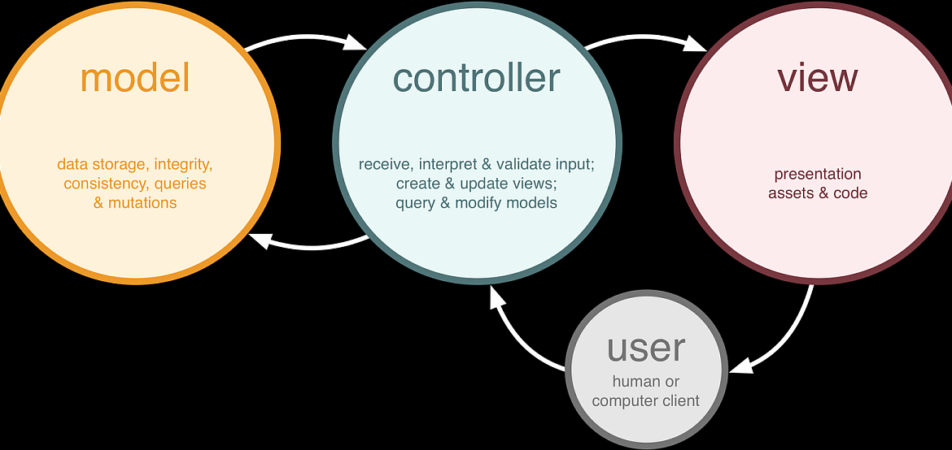
MVC
6

Slide 13
Thanks!
Any questions?

